Slide 1
Machine Learning on .NET - Getting Started
Bahrudin Hrnjica, PhD, MVP
@bhrnjica
bhrnjica@daenet.de

Slide 2


https://guidnew.com
https://www.energy-services.at

Slide 3
Dr. Sc. Bahrudin Hrnjica,
University professor,
IT Consultant, Software Developer, 20 years,
10 years as Microsoft Most Valuable Professional, MVP
C# MVP
.NET MVP
Developer Technologies
12 years in Machine Learning, (lot of books, papers, conference, ..)
GPdotNET – Genetic Programming tool, since 2009 on GitHub
ANNdotNET – ANN on .NET Platform, 20

Slide 4

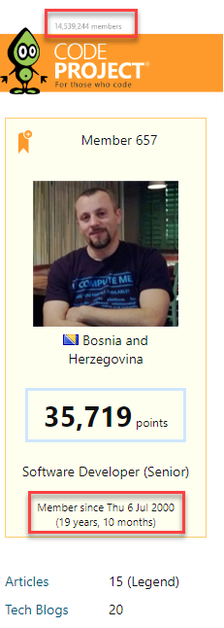


Slide 5
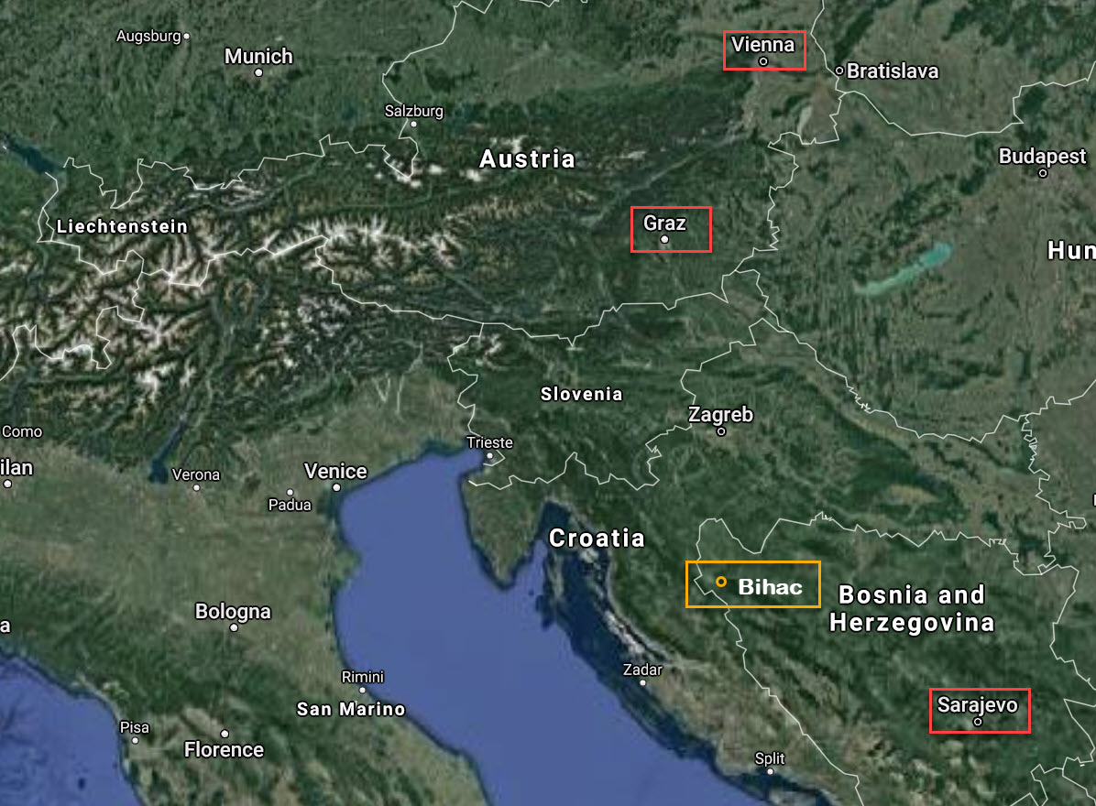


Slide 6
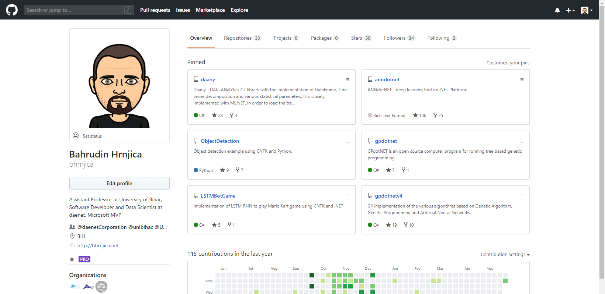

Slide 7
Machine Learning on .NET - Getting Started
AGENDA
Introduction to ML
ML.NET
AI, ML …
Give me some code
Quick Intro
Phone Detector - Blazor&ML.NET Application
Ml.NET Architecture
Pipe Pattern
What is Machine Learning
How to become ML expert in 1 minute
Summary
Q&A

Slide 8
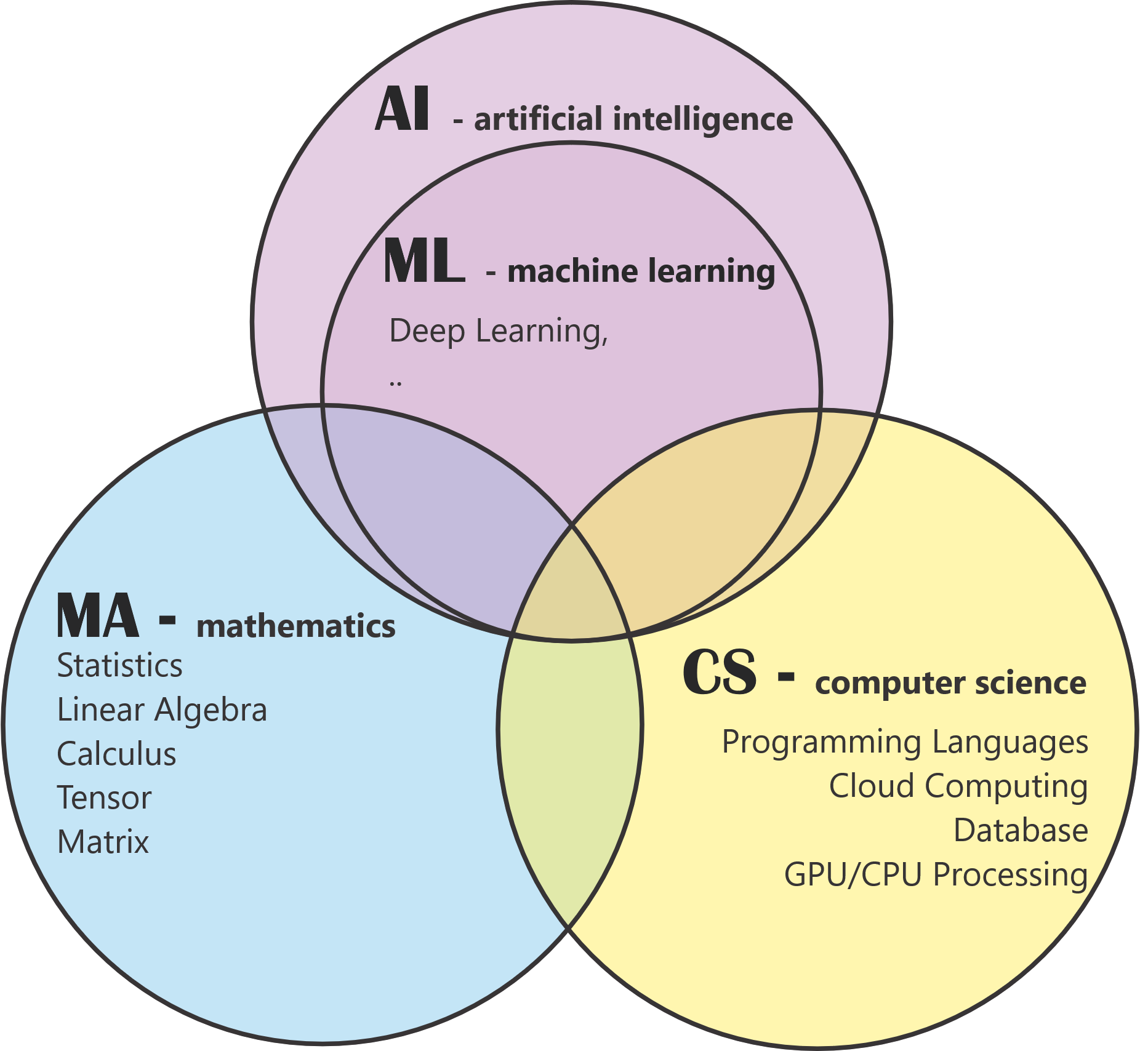
Artificial Intelligence vs. Machine Learning

Slide 9
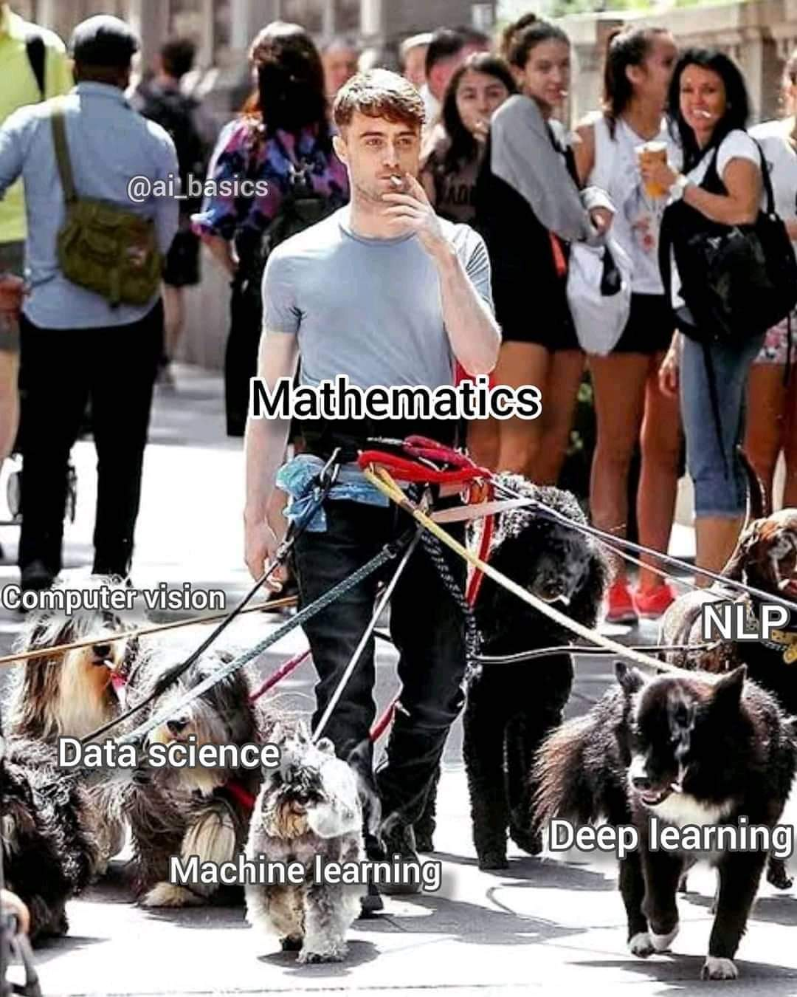

Slide 10
Machine Learning?
method of teaching computers to make predictions based on data.
always starts from data,
the goal is knowledge extraction,
involves some amount of automation in form of algorithm and computer to do the job,
it requires many smart decisions by a human
can be completely automate in form of AutoML.

Slide 11
Traditional Programming vs. Machine Learning
Traditional Programming
Machine Learning
Data
Computer
Output
Program
Data
Computer
Program
Output

Slide 12
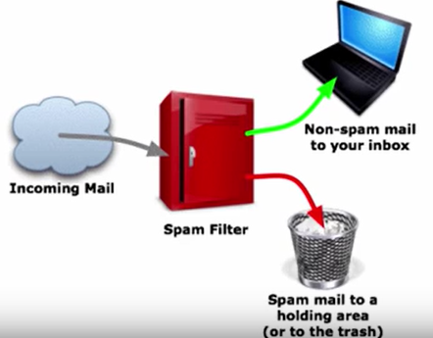
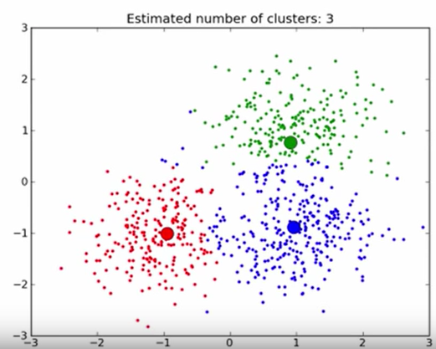

Three Types of Machine Learning
Reinforcement learning
- Computer interacts with dynamic sys,
It must achieve goal,
Feedback how last action passed,
Computer learns based on feedback.
Example
Supervised ML
Maps inputs to outputs
Data is divided on two sets
Training and Testing
Unsupervised ML
Output is not provided
Algorithm tries to extract similarities (patterns)

Slide 13
Types of Supervised Machine Learning
Supervised ML
Classification (Label- discrete value)
Regression (Label – continuous value)
Binary Classification
Multiclass classification

Slide 14

How to become a ML expert in 5 minutes -
DEMO

Slide 15
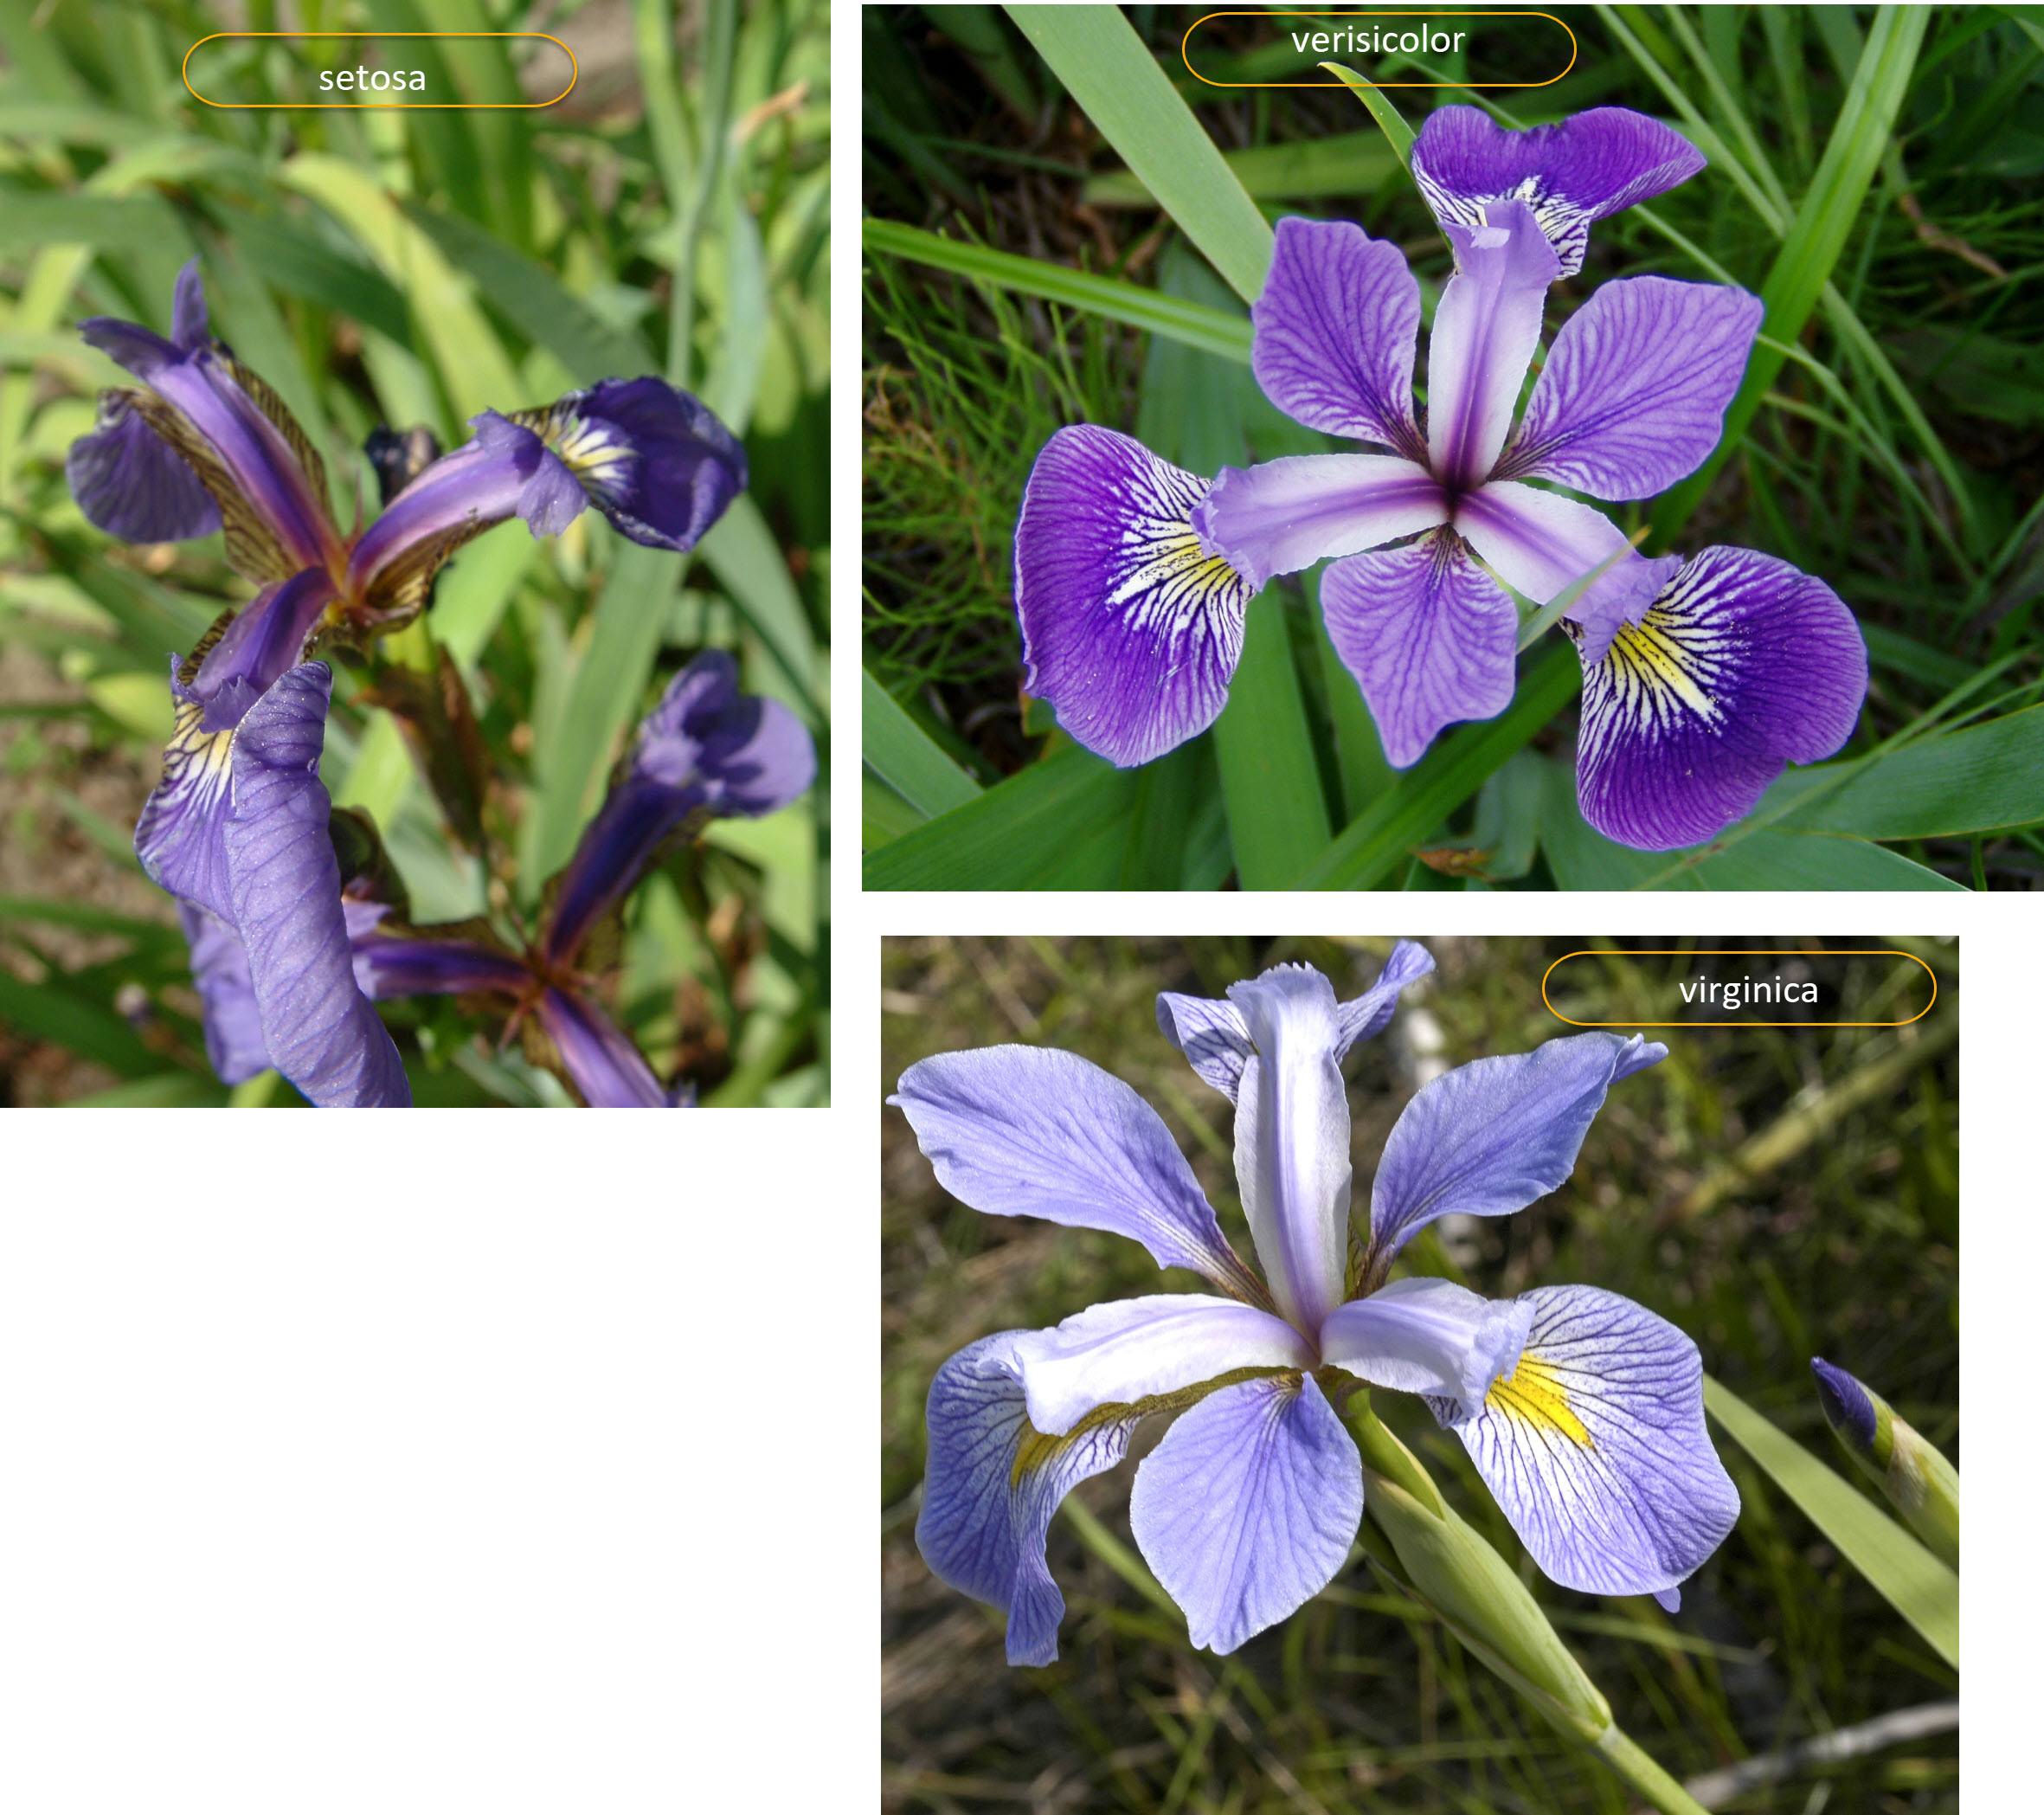
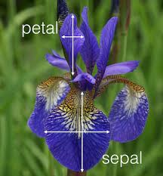
Recognize Iris flower type- Introduction
Iris data set contains 150 measures of sepal and petal of Iris flower types: setosa, verisicolor and virginica

Slide 16
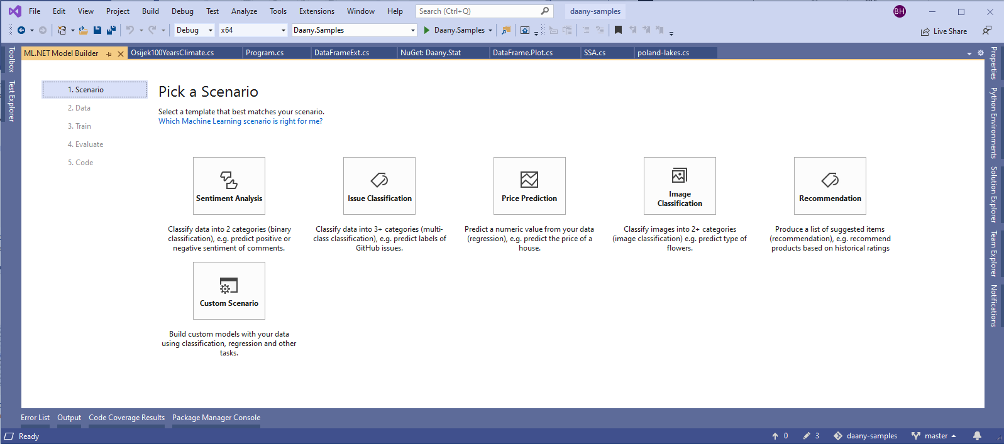
Using VS Model Bilder to recognize Iris flower

Slide 17
Machine Learning Project Lifecycle
1. define problem
2. acquire + process data
6. deploy
3. design model architecture
5. test/evaluate
4. train model
a. Initialize and select ml algorithm
y =Wx + b
b. feed in minibatch of data
e. update weights
d. optimize: minimize loss
c. calculate loss
δ
loss = |desired – actual outcome|

Slide 18





ML.NET An open source and cross-platform machine learning framework
Built for .NET developers
Custom ML made easy with tools
C#
F#
Extended with TensorFlow & more
Trusted &
proven at scale
http://dot.net/ml
Notes:
Use existing .NET skills to easily integrate ML models into your .NET apps
Productive tooling
Leverage other popular libraries like TF and ONNX for additional scenarios
TLC

Slide 19
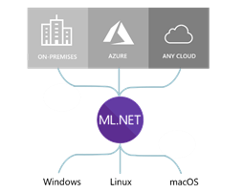
ML.NET runs anywhere
Supported processor arch.
x64
x86

Slide 20
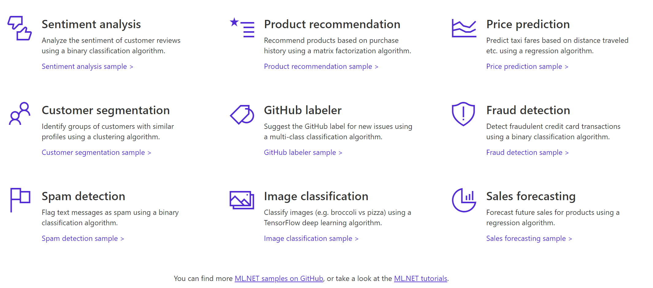

A few things you can do with ML.NET …
And more! Samples @ https://github.com/dotnet/machinelearning-samples
Notes:
So here’s an example of a few things you can do today with ML.NET 1.0
You can perform Sentiment Analysis, build Product recommenders,
forecast sales,
classify images and do a whole lot more.
And for all these scenarios we have provided you sample code for building and consuming these models, let me show you.
____
Dot.net
Here’s our dot.net/ml page which talks about some of the value props I mentioned, heres a list of samples.
So here is our samples repo, Here we have many samples for each ML task e.g. Fraud Detection for classification, Issue Classification, Sales Forecast etc.
For each of these samples we also provide you both the training code and consumption code along with explaining you how we built them
Alright so let me show you one of these samples live.
Here I have the sentiment analysis + blazor application

Slide 21
ML.NET components
Developer friendly API for Machine Learning
ML Model Training & Consumption
Data
Training ML tasks
Model Consumption
& Evaluation
Extensions & Tools
IDataView (Data set)
Classical ML
Classification
Regression
Anomaly Detection
Recommendations
Time Series
Ranking
Clustering
Consumption
Model
Prediction Engine
Prediction Engine Pool
ONNX integration
File Loaders
TensorFlow integration
Database Loader
Evaluation
Model Evaluators
Quality metrics
AutoML
Image Loader
CLI (Command-Line Interface)
Data Transforms
Computer Vision
Image classification (Train)
Object Detection (*)(Train)
Model Builder in VS
Jupyter notebooks (**)
(+40 trainers/algorithms)
Notes:
https://towardsdatascience.com/deep-learning-vs-classical-machine-learning-9a42c6d48aa

Slide 22
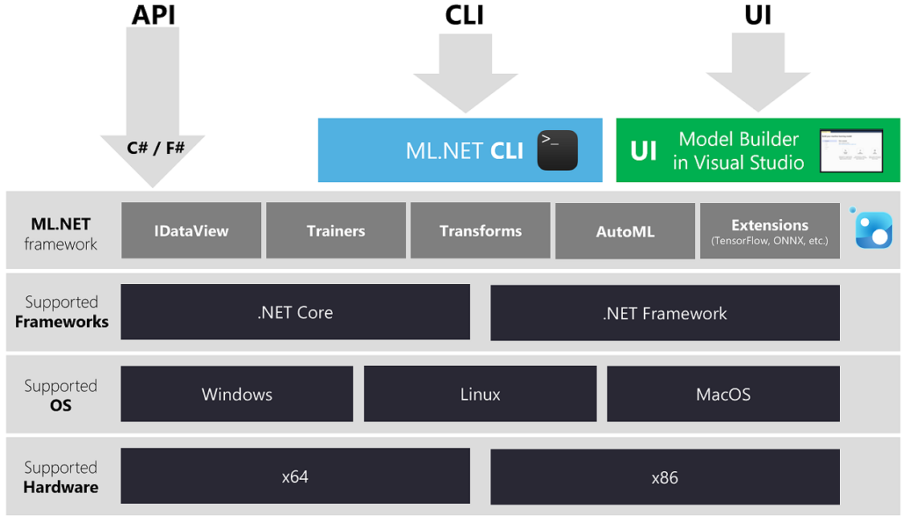
Architecture of ML.NET

Slide 23
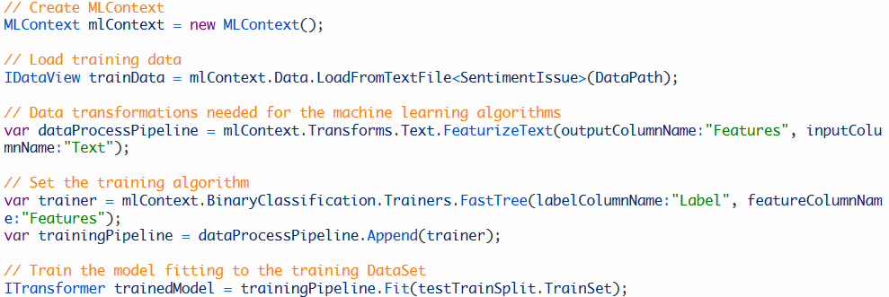
Getting Started with ML.NET
Install Nuget Package dotnet add package Microsoft.ML (Install-Package Microsoft.ML)
Train your own ML model

Slide 24
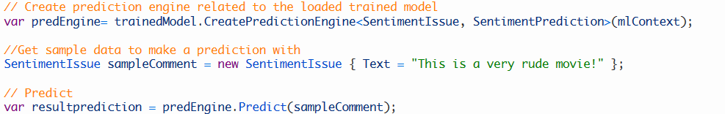
Getting Started Installation
Consuming ML.NET models in your end-user apps

Slide 25

Cool ML.NET Application
DEMO

Slide 26
Nokia 3310 - Detector
The most common scenario in .NET where to use Machine Learning
Building Machine Learning solution on .NET from zero
Using Blazor App – as .NET Solution that consumes the ML Model
Using ML.NET set of packages for building, training and testing ML Model
Complete solution including trained images and trained model are at GitHub
https://github.com/bhrnjica/Detector

Slide 27
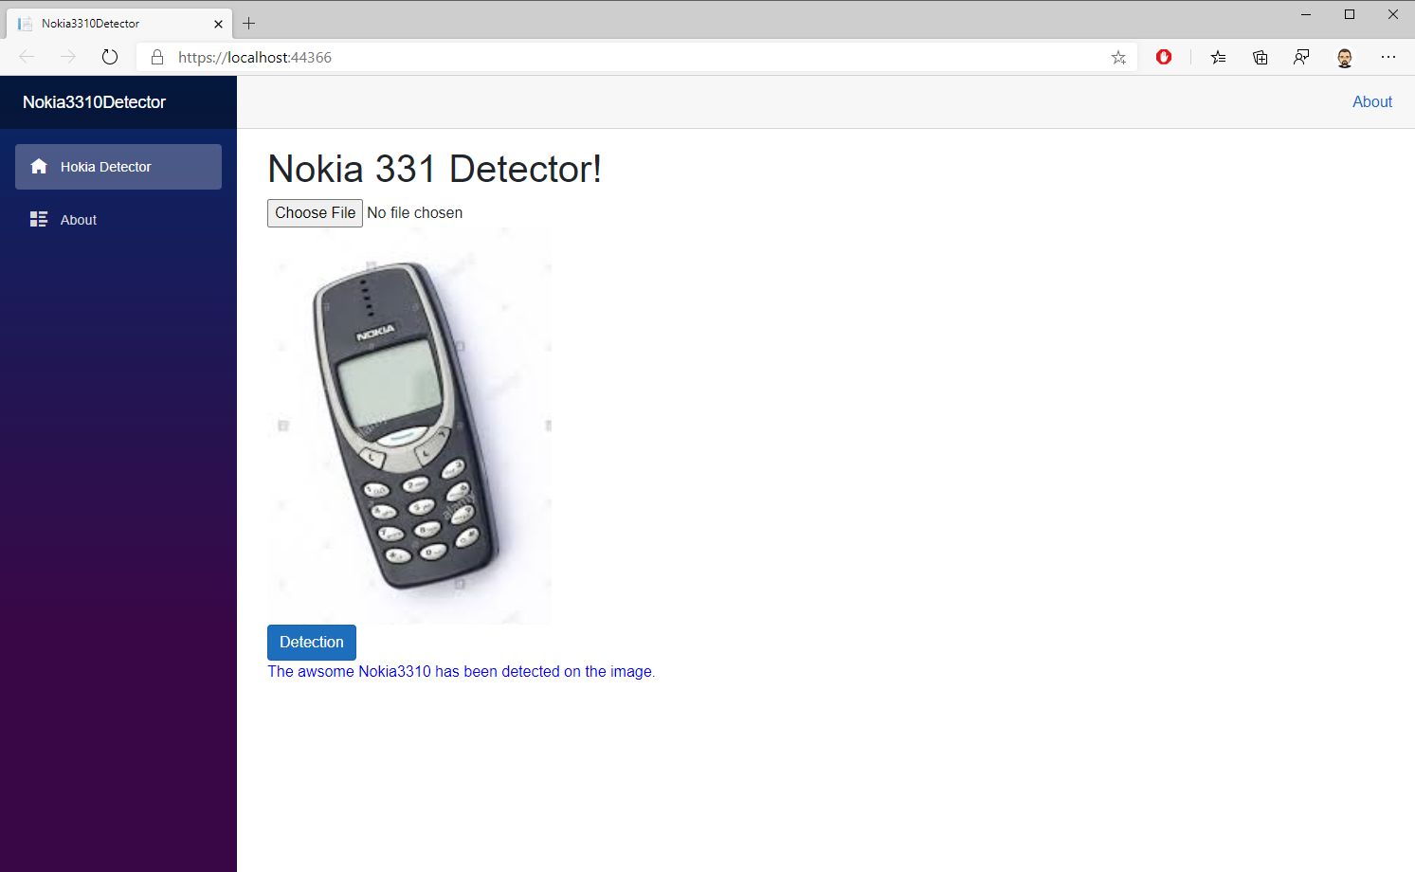

Slide 28
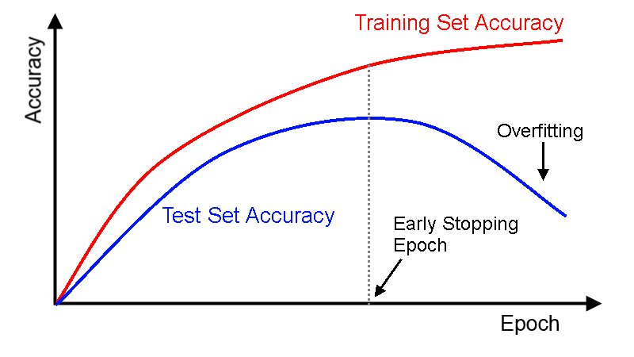
1 M$ question when to stop with training.

Slide 29
Good to know
Machine learning means learning from data; AI is a buzzword
Machine learning is about data and algorithms, but mostly data.
Unless you have a lot of data, you should stick to simple models.
Machine learning can only be as good as the data you use to train it.
Machine learning only works if your training data is representative.
Most of the hard work for machine learning is data transformation.
Deep learning is a revolutionary advance, but it isn’t a magic bullet.
Machine learning systems are highly vulnerable to operator error.
AI is not going to become self-aware, rise up, and destroy humanity.

Slide 30
Q&A
Q&A

